Slide 1

Capstone Project Hotel Booking Analysis
Team members
Kanhaiya Kurmi
Amit Adhaye
Vaibhav Jaiswal

Slide 2
Point To Discuss:
Agenda / Problem identification
Questions identified / Problem statement
Data summary
Data cleaning & Data preparation
Univariate analysis
Hotel wise analysis
Age Group Analysis
Booking cancellation analysis
Time wise analysis
Combined analysis
Hotel wise booking and stay Analysis
Arrival year wise price per guest analysis
Distribution Channel wise ticket booking/cancellations count
Arrival year wise price per guest analysis
Relation between assigned room type meal
preferred by customers and price per guest
Conclusion

Slide 3
Agenda
To discuss the analysis of given hotel bookings data set from 2015-2017.
To find out the patterns that will help us to increase the hotel bookings.
To discus some important python modules that are frequently used in numerical computation, data manipulation and graphical representation of historical data.
Analysis of given data set in following ways :
Data Cleaning
Hotel wise analysis
Univariate analysis
Distribution Channel wise analysis
Booking cancellation analysis
Time Wise Analysis
Country based analysis.
Find out key factors to grow the hotel booking trends.

Slide 4
Questions identified / Problem statement
In this EDA we will perform analysis on following Questions :
What is the bookings ration between Resort and City hotels?
How many ticket were canceled during booking and after booking?
Which month is the most occupied and which is the least occupied?
What is % booking for each year?
Which market country is contributing max booking?
What meal item mostly preferred by customer?
what is the price per guest in each booking?
Which market segments should be targeted for promotion?

Slide 5
Data Summary
Given data set has different columns of variables crucial for hotel bookings. Some of them are as following:
hotel: this column includes category of hotels, which are City Hotel and Resort Hotel.
Is_cancelled: The value of column can show the cancellation type. If the booking was cancelled or not. Values[0,1], where 0 indicates not cancelled.
lead_time: The time between reservation and actual arrival.
stayed_in_weekend_nights: The number of weekend nights stay per reservation.
stayed_in_weekday_nights: The number of weekday nights stay per reservation.

Slide 6
Contd…
market_segment: This column show how reservation was made and what is the purpose of reservation. Eg, corporate means corporate trip, TA for travel agency.
distribution_channel: The medium through booking was made.
[Direct,Corporate,TA/TO,undefined,GDS.]
Is_repeated_guest: Shows if the guest is who has arrived earlier or not.
Values[0,1]-->0 indicates no and 1 indicated yes person is repeated guest.
days_in_waiting_list: Number of days between actual booking and transact.
customer_type: Type of customers( Transient, group, etc.)

Slide 7
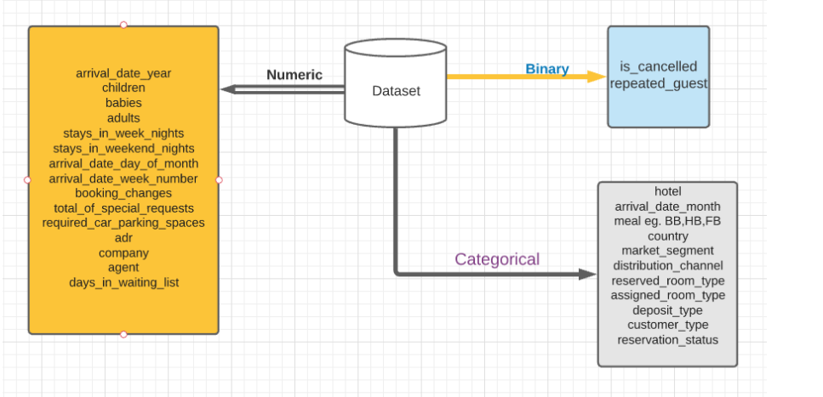
Data Summary

Slide 8
Data Cleaning & Data Preparation
Data cleaning is one of the important parts of exploratory data analysis(EDA). It plays a significant part in building a model.
If we have well- cleaned dataset, there are chances that we can get achieve good results with simple algorithms also, which can prove vey beneficial at times especially in terms of computation when the dataset size is large.
Obviously, different types of data will require different types of data cleaning. However, this systematic approach can always serve as good starting point.
Steps involved in Data Cleaning:
Removal of unwanted observations
Fixing structural errors
Managing unwanted outliers
Handling missing data

Slide 9
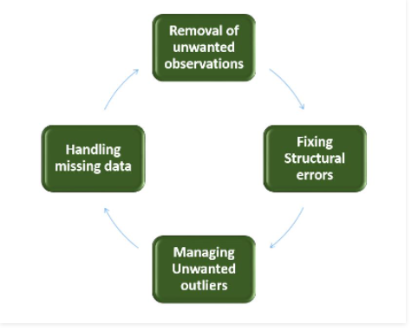
Contd…
Removal of unwanted observations includes deleting duplicate/ redundant or irrelevant values from dataset.
Duplicate observations most frequently arise during data collection and irrelevant observations are those that don’t actually fit the specific problem that you are trying to solve.
The errors that arise during measurement, transfer of data or other similar situations are called structural errors.

Slide 10
Contd…
Outliers can cause problems with certain type of models. For example liner regression models are less robust to outliers than decision tree models.
We can not just ignore or remove missing observation. They must be handled carefully as they can be an indication of something important. The two most common ways to deal with missing data are:
Dropping observations with missing values
Imputing the missing values from past observations
So, we have discussed four different steps in data cleaning to make the data more reliable and to produce good results.
After properly completing the Data cleaning steps, we have good and a robust dataset that avoids many of the most common errors.

Slide 11
Univariate Analysis
While doing univariate analysis of given hotel booking dataset, we answered following questions:
Which agent made most of bookings?
Which room type is in most demand and which room type generates highest adr?
From which country most of the customers are coming?
What is the most preferred meal by custom

Slide 12
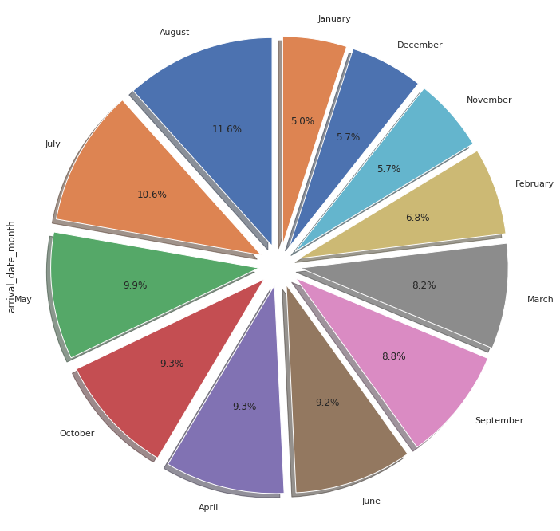
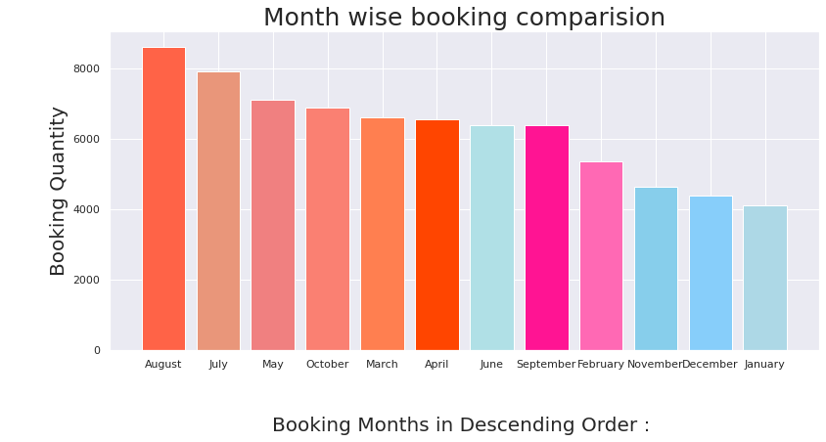
Month wise analysis
August month has more booking request as compare to other.
January month has least bookings.

Slide 13
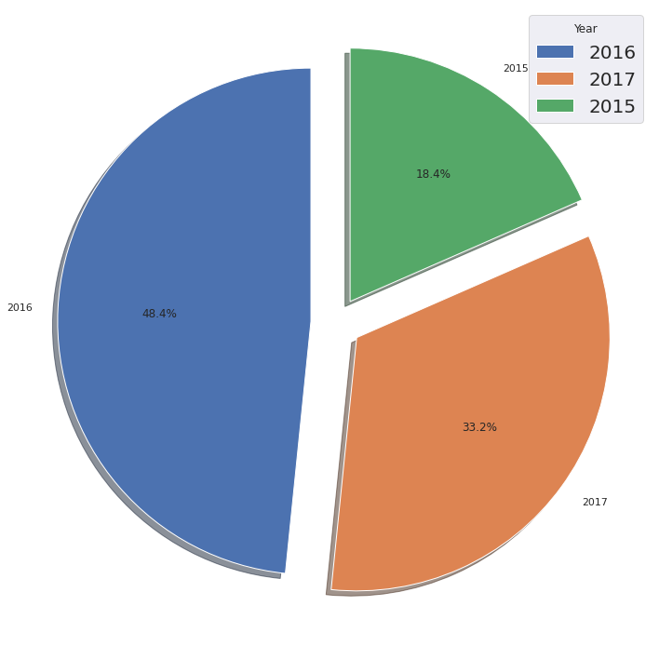
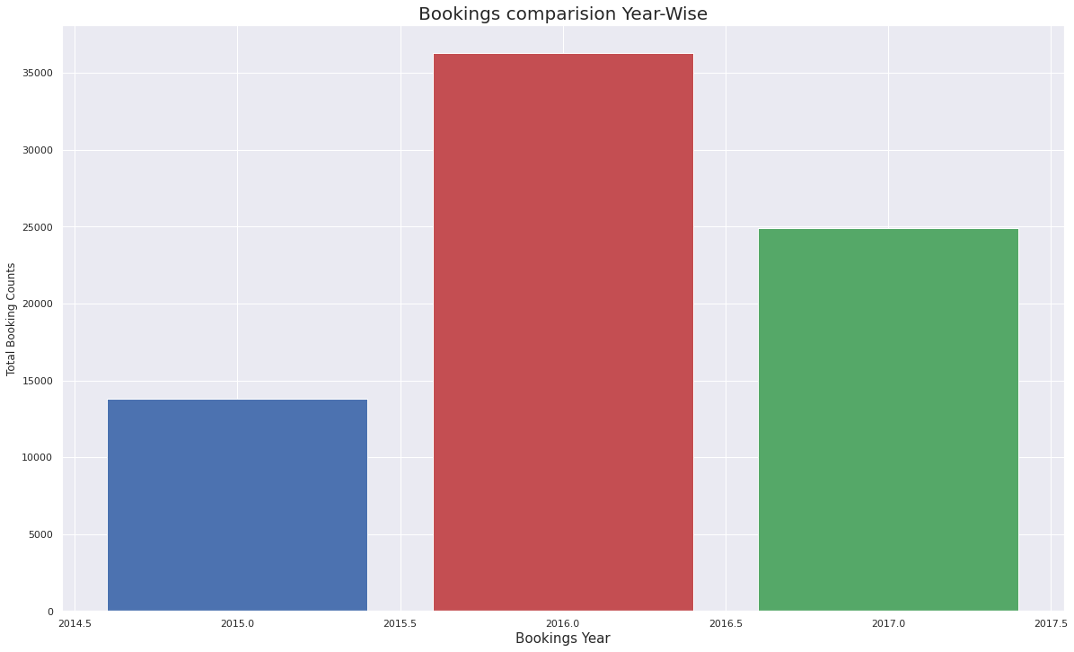
Year wise analysis

Slide 14
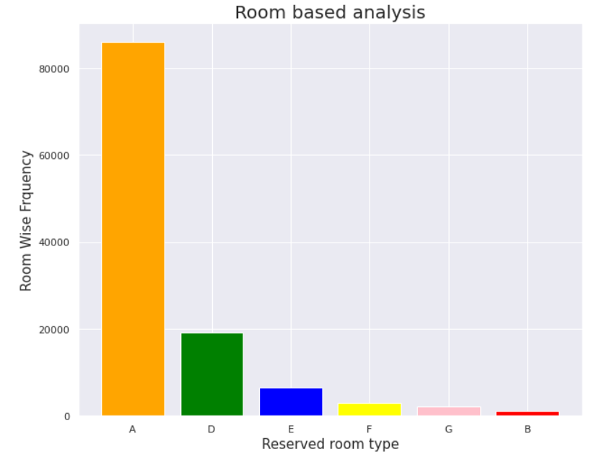
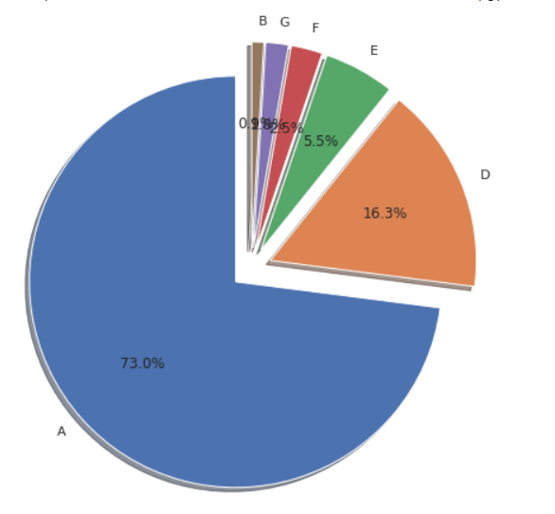
Room based analysis
Both graphical representation showing the demand of reserved room type.
Room type ‘A ‘ most demanded by customers.Then room type ‘D’ and so on.

Slide 15
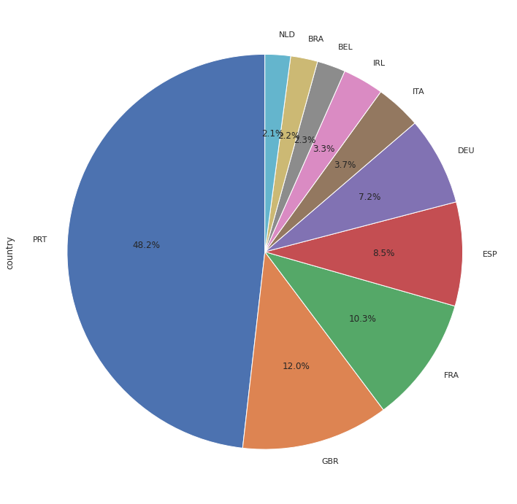
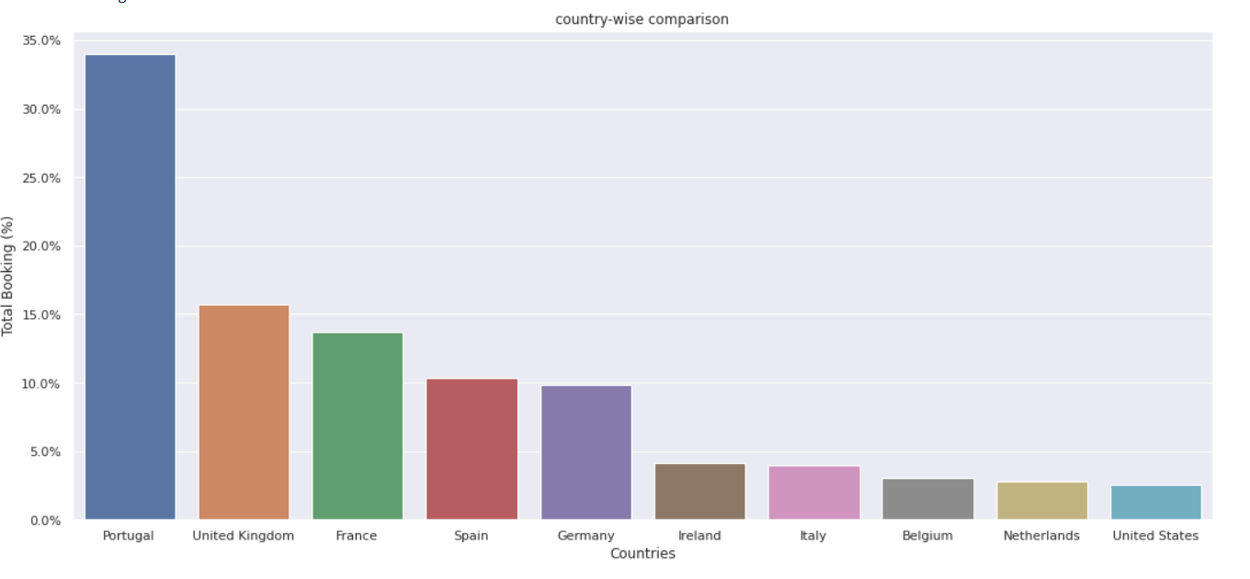
Countrywide comparison
Most of the customers from European countries like
Portugal, United Kingdom, France, Spain and Germany.
Maximum customers came from Portugal then United Kingdom.

Slide 16
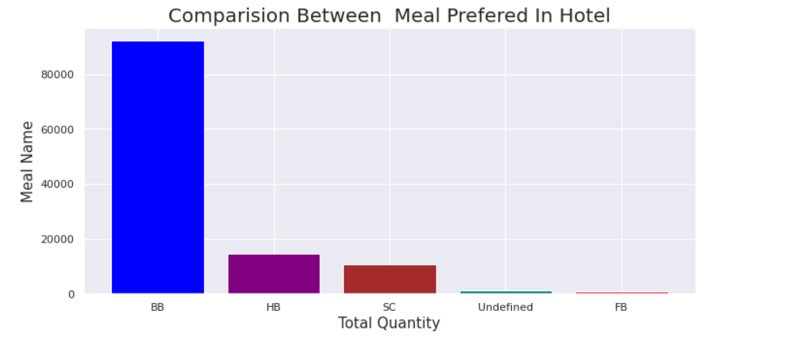
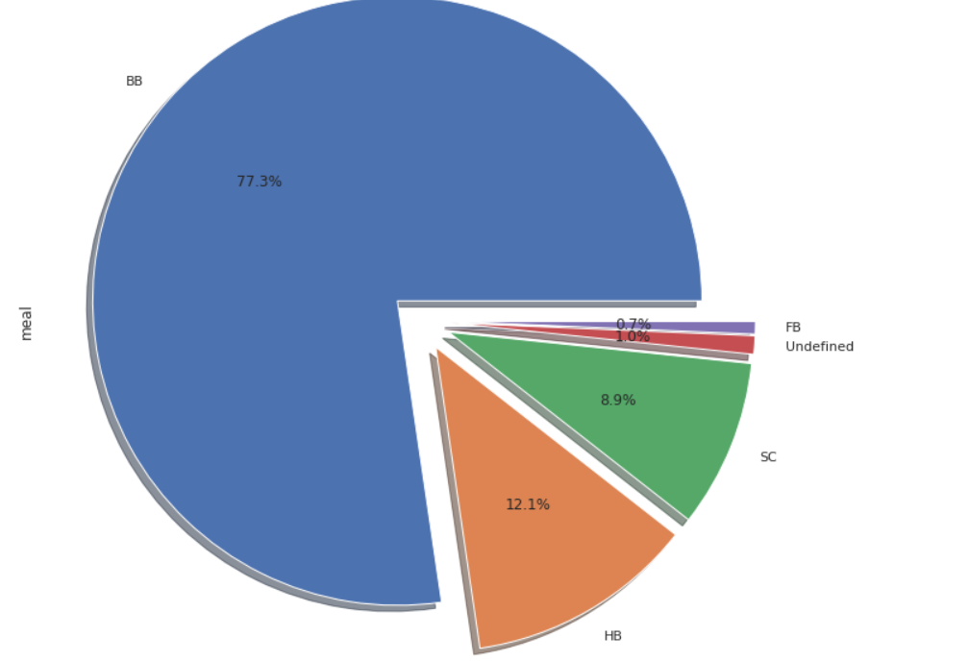
Meal type comparison
There are almost five types of meal presented in the data set.
Most preferred meal type is BB (Bed and breakfast).
BB: means Bed and breakfast
HB : means half board : in which breakfast and dinner are included.
SC: means self-catering (no meals are included)
FB: means full board

Slide 17
Hotel wise Analysis
While doing hotel-wise analysis of given hotel booking dataset, we answered following questions:
Percentage of bookings in each hotels?
Which hotel has higher lead time?
For which hotel, does people have to wait longer to get a booking confirmed?
Which hotel has higher booking cancellations rate?
Which hotel have higher and how much customer returning rate?

Slide 18
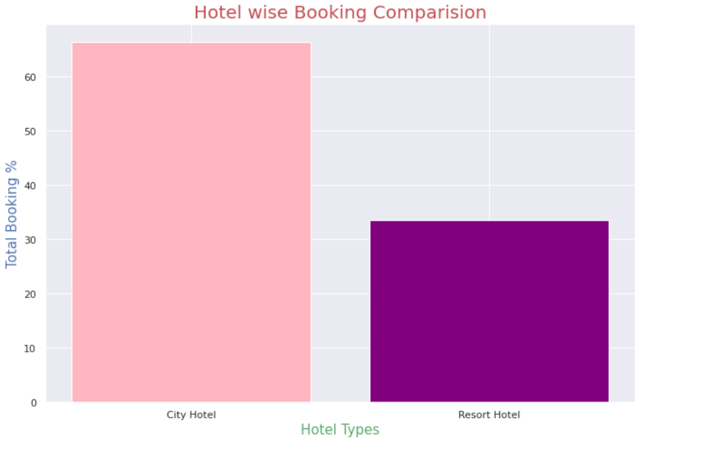
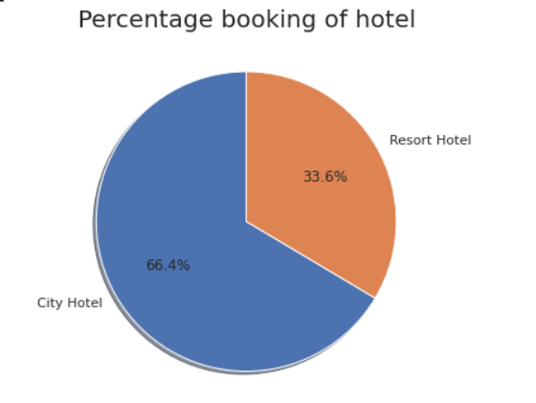
Hotel wise Analysis
Around 60% of customers booked the city hotel and 40% customers booked the resort hotel

Slide 19
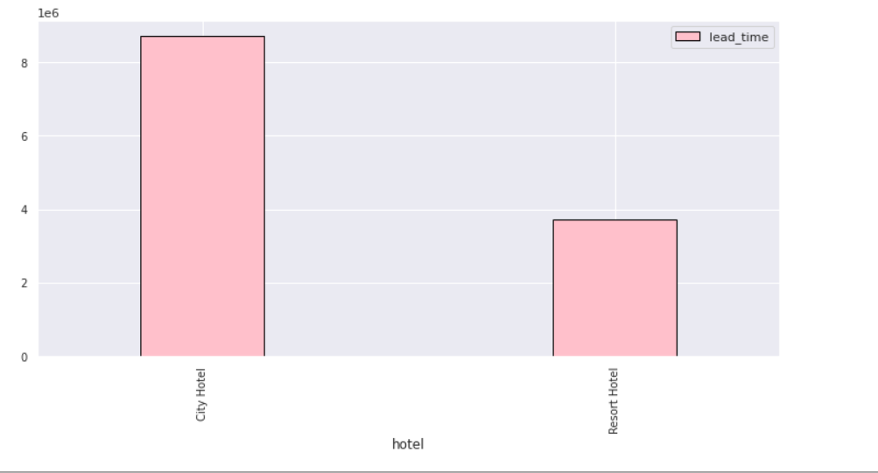
Lead time Analysis
City hotel has higher lead time as compare to Resort Hotel

Slide 20
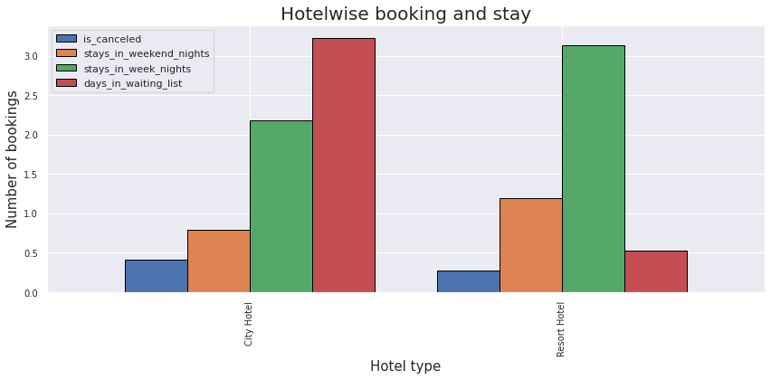
Hotel wise booking and stay Analysis
City hotel cancelation rate is higher than Resort Hotel,
Resort hotel has longer stays time in weekend days as compare to City hotel.
City hotel has less stays in week day nights .
City hotel has significantly longer waiting time, hence City Hotel is much busier than Resort Hotel.

Slide 21
Distribution channel wise Analysis
Which is the most common channel for booking hotels?
Which channel is mostly used for early booking of hotels?
Which distribution channel brings better revenue generating deals for hotels?

Slide 22
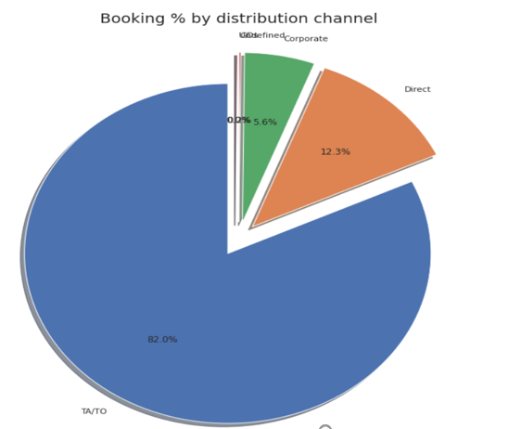
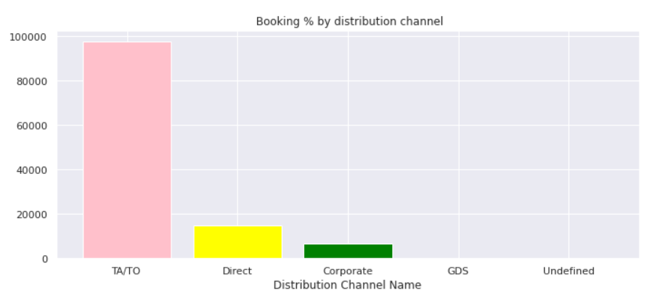
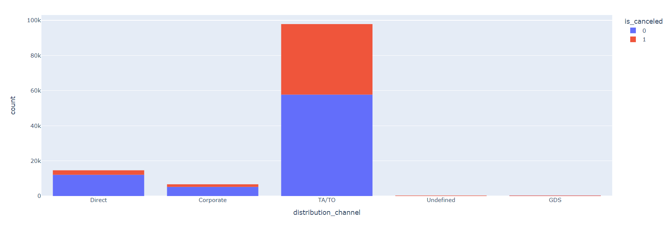
Contd…
Here we can see that the most of guest are making reservation
through TA/TO channels which is travel agency and tour operator.
Than the second most used channel is direct.
Channel which is mostly used for early booking of hotels is also TA/TO.
Distribution Channel wise ticket booking/cancellations count

Slide 23
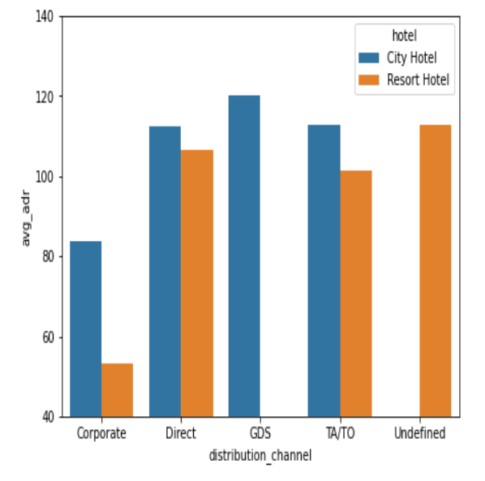
Contd…
GDS channel brings higher revenue generating deals for City hotel, in contrast to that most bookings come via TA/TO. City Hotel can work to increase outreach on GDS channels to get more higher revenue generating deals.
Resort hotel has more revenue generating deals by direct and TA/TO channel. Resort Hotel need to increase outreach on GDS channel to increase revenue.

Slide 24
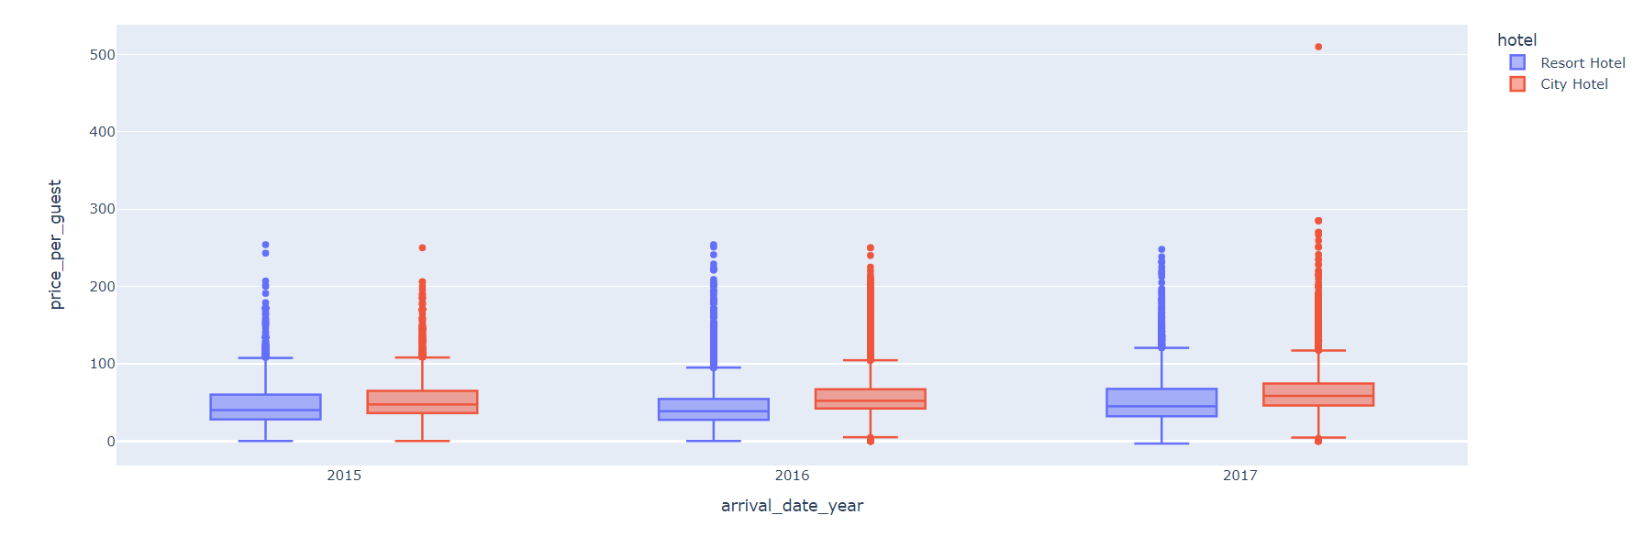
Arrival year wise price per guest analysis
The equation to calculate price per guest is
Total Guests stayed = no of (adults + children + babies)
Price per guest = Avg Daily Rate / Total guest stayed
In this graph, price per guest of both hotels City and Resort Hotel are same in year 2015 and 2016 but in year
2017 price per guest of City Hotel had greater than Price per guest of Resort Hotel

Slide 25
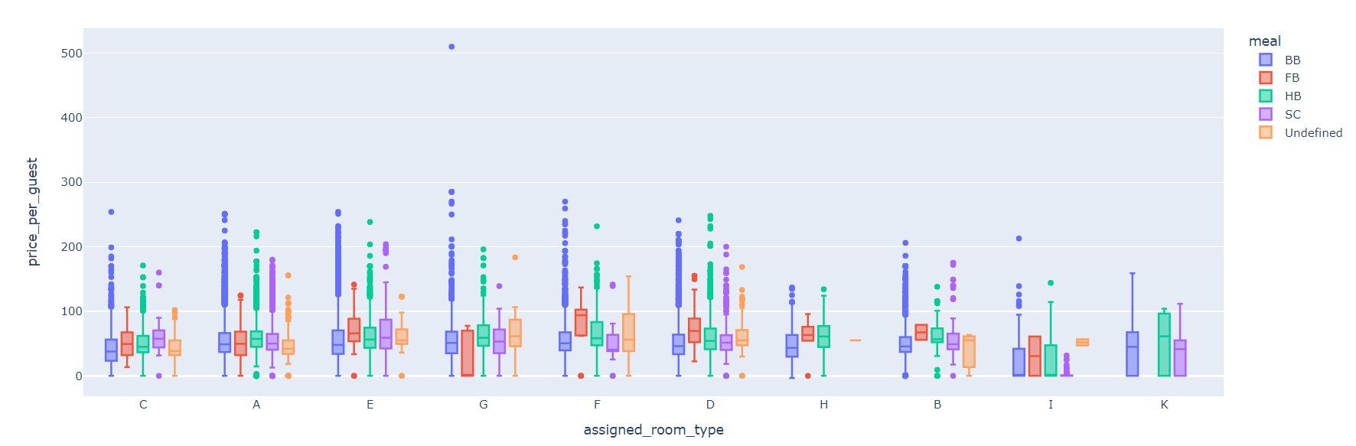
Relation between assigned room type meal
preferred by customers and price per guest
It will be interesting to see how much the customers coming from various channels pay daily.
It can be observed that TA/TO distribution channel is the best performer.

Slide 26
Conclusion
Around 60% bookings are for City hotel and 40% bookings are for Resort hotel, therefore City Hotel is busier than Resort hotel. Also the overall adr of City hotel is slightly higher than Resort hotel.
Mostly guests stay for less than 5 days in hotel and for longer stays Resort hotel is preferred.
Most of the guests came from European countries, with most no. of guest coming from Portugal.
Guests use different channels for making bookings out of which most preferred way is TA/TO.
For hotels higher adr deals come via GDS channel, so hotels should increase their popularity on this channel.
Almost 30% of bookings via TA/TO are cancelled.
Not getting same room as reserved, longer lead time and waiting time do not affect cancellation of bookings. Although different room allotment do lowers the adr.
July- August are the most busier and profitable months for both of hotels.
Within a month, adr gradually increases as month ends, with small sudden rise on weekends.
Couples are the most common guests for hotels, hence hotels can plan services according to couples needs to increase revenue.

Slide 27
Summary
In this hotel booking EDA, our team has identified the various outliers in different category of fields in the data such as year wise, month wise bookings, stay, cancellation and lead time comparisons between two hotel categories, market share of each entity w.r.t cancelled and booked, meal preferences by guest, the price per guest and its relationship to type of room and meal type etc.,. This EDA will play important role in identifying various key features in hotel booking demand analysis

Slide 28
Thank You

